Slide 1

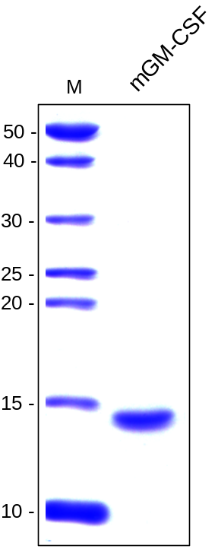
ReliaTech GmbH
Recombinant mouse GM-CSF
(Cat #M30-013 / -014 )
Fig. 1: SDS-PAGE analysis of recombinant mouse GM-CSF derived from E. coli. Sample was loaded in 15% SDS-polyacrylamide gel under reducing conditions and stained with Coomassie blue.
http://www.reliatech.de / orders@reliatech.de

